Slide 1


A Community Resource to Fight Illegal Dumping
IllegalDumpFreePA.org

Slide 2

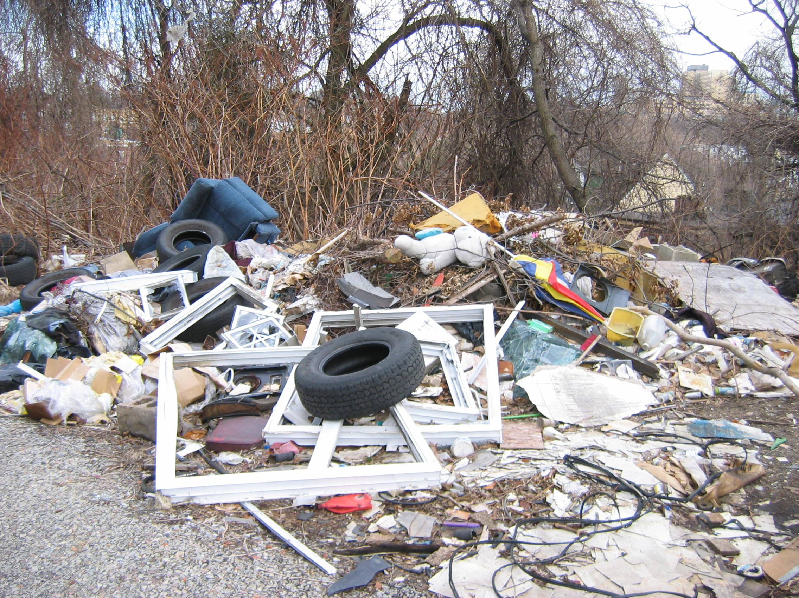
Illegal Dumping in Pennsylvania
Top Five Items Identified in Pennsylvania Illegal Dumps
Household Trash
Tires
Construction and Demolition Waste
Bagged Waste
Yard Waste
It costs on average $619 per ton, with an
cost per cleanup per remediated site
at $2,947.

Slide 3
Why Go Beyond Cleanups?
Cleanups of active dumpsites are ineffective in and of themselves.
The Cyclical Dilemma
The mere presence of a dump site encourages more dumping.
Cleaning up active sites signals taking responsibility for managing the material and invites more dumping.
Lessons Learned
Cleanups must occur to reduce the impact on the environment.
Cleanups have a lasting effect when mechanisms exist to prevent and deter illegal dumping from reoccurring.

Slide 4
Providing tools and resources to keep our
communities clean and beautiful.
The Surveillance Camera Loan Program - KPB provides a ready to mount, user friendly surveillance camera kit complete with wireless and black-flash technology and technical assistance for installation.
Mini-grants for Deterrents - Resources to help deter future dumping once enforcement actions have been taken and sites have been cleaned.
Public Education Resources - Tools to educate both community members and stakeholders about the economic and environmental impacts of illegal dumping.

